Slide 1
COMMUNE ACTION PLAN

Slide 2
Table of COntent
1. Accessibility of the Platform
I.a Hanwash Home Page
I.b Login Process & Accessing the CAP console
1.c CAP Console
II. Functionalities
II.a Quick Filters
II.b Map
II.c Charts
II.d Charts & Pivot Table
II.e Donut Charts

Slide 3
C.A.P
Accessibility of the platform

Slide 4
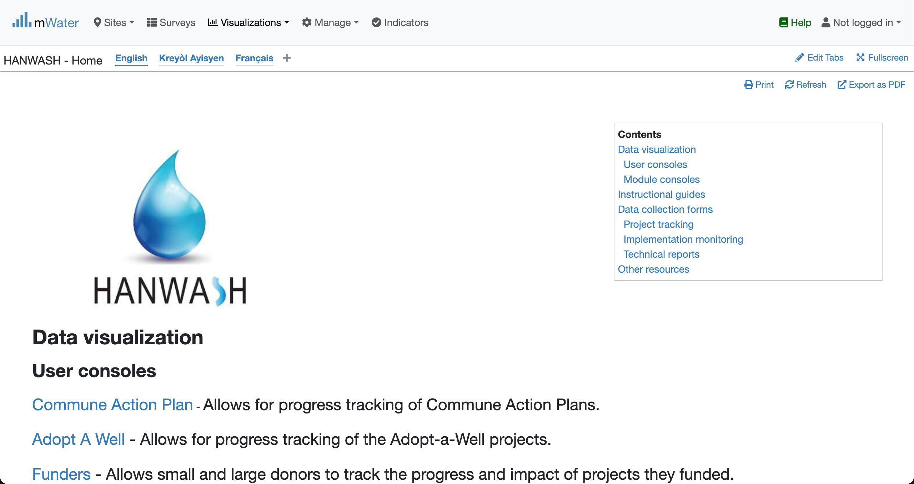
Hanwash HOME
URL LINK : http://go.mwater.co/hanwash

Slide 5
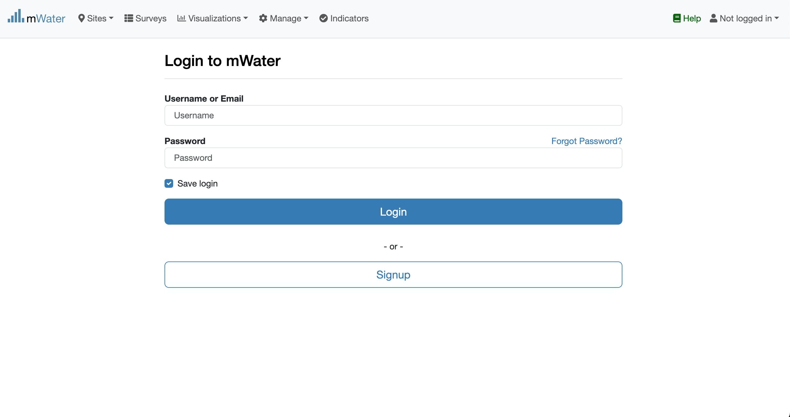

Access The CAP & Login process
Click on the CAP url link
Not Logged in
Please enter your Credentials

Slide 6

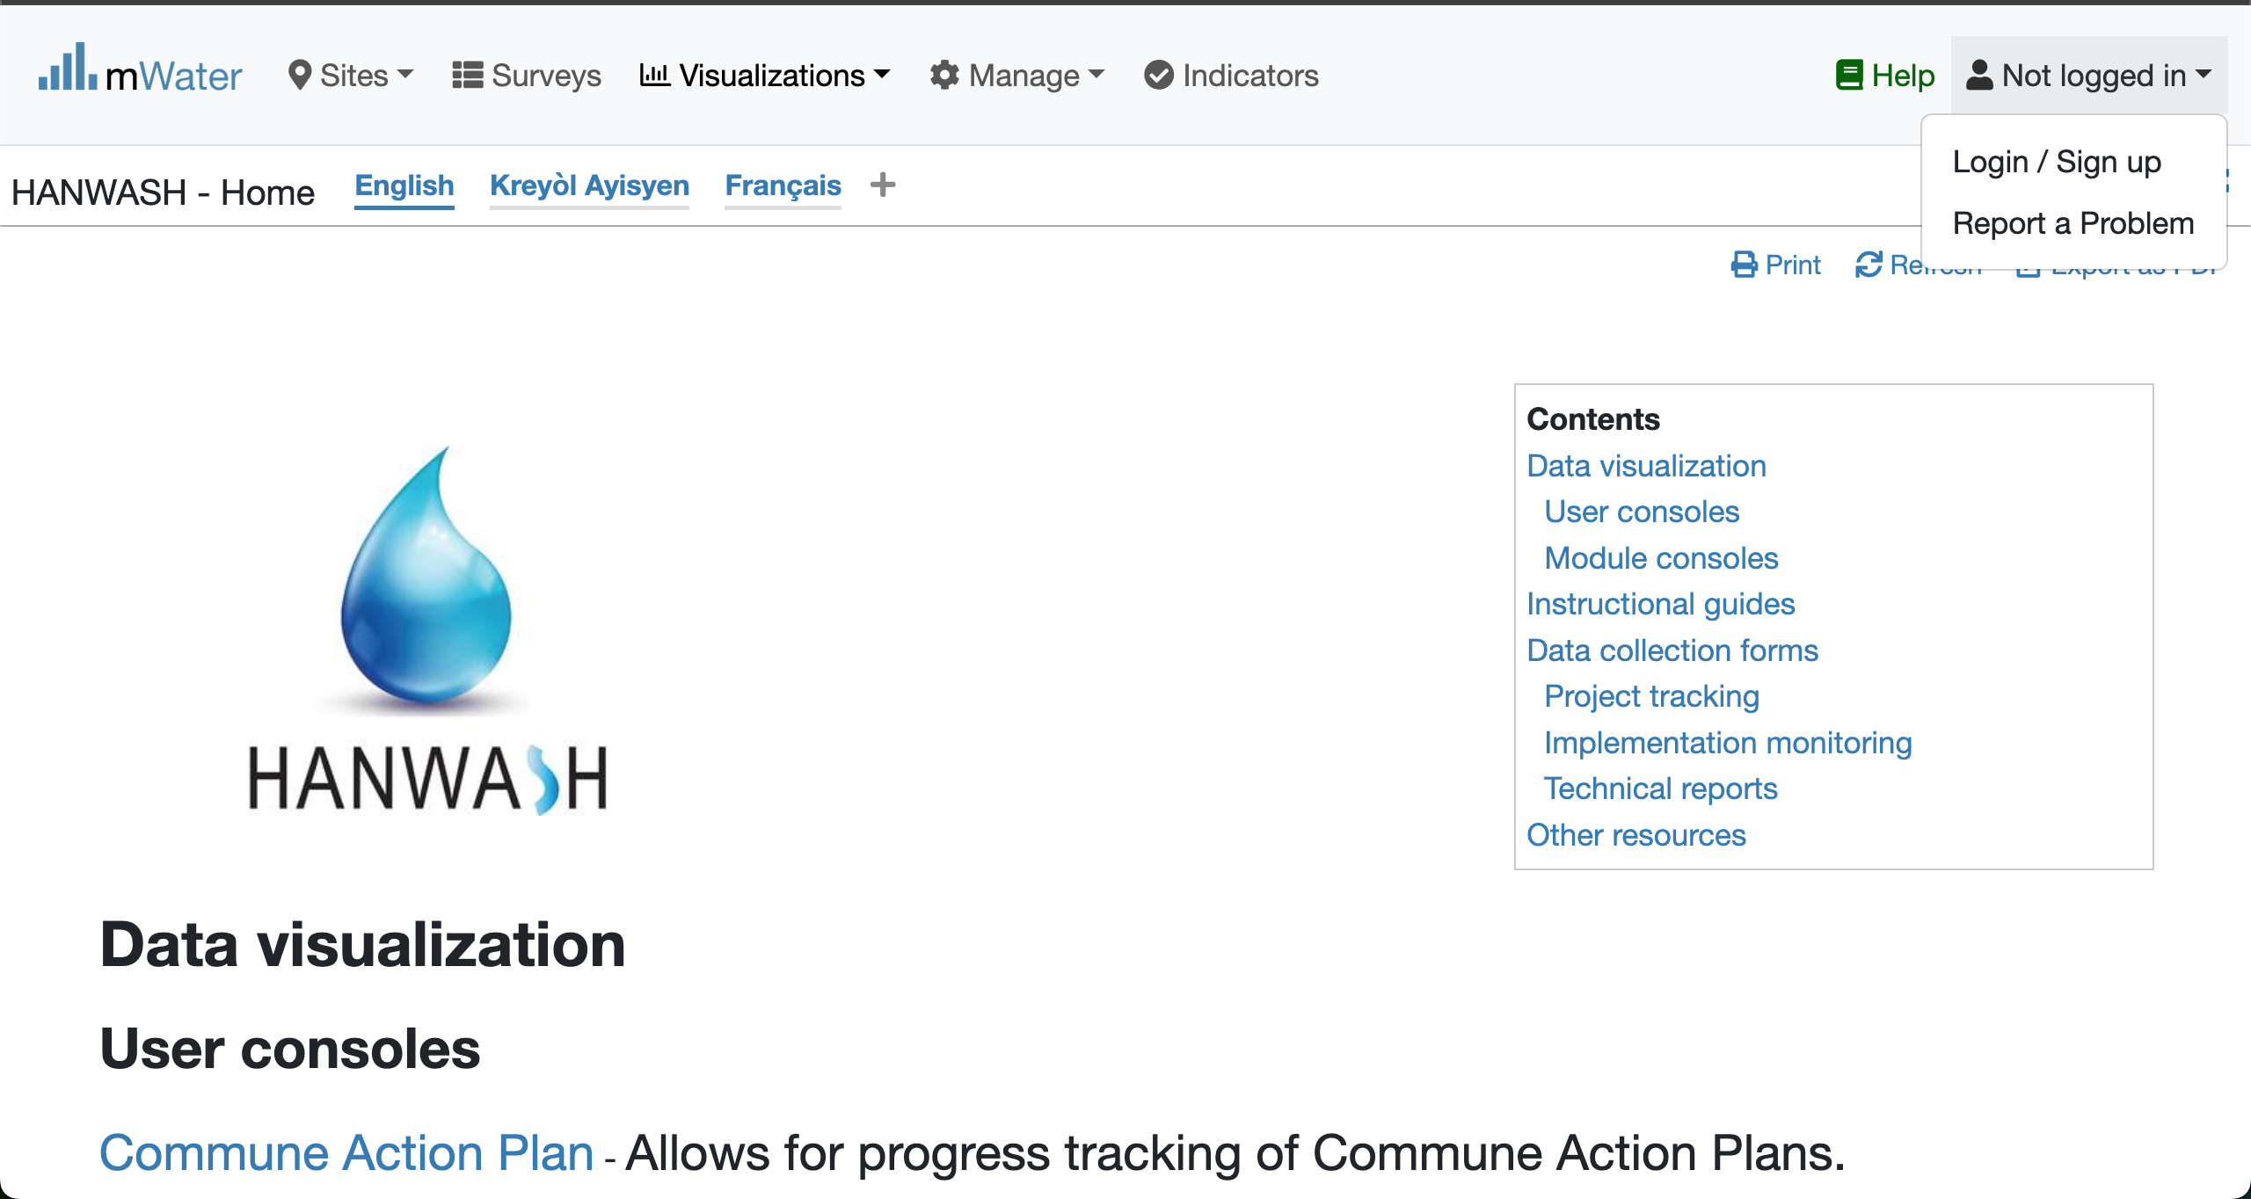

Login Process (2nd scenario)
Click to Login or Signup
Please Click on this selection box
Please enter your Credentials

Slide 7
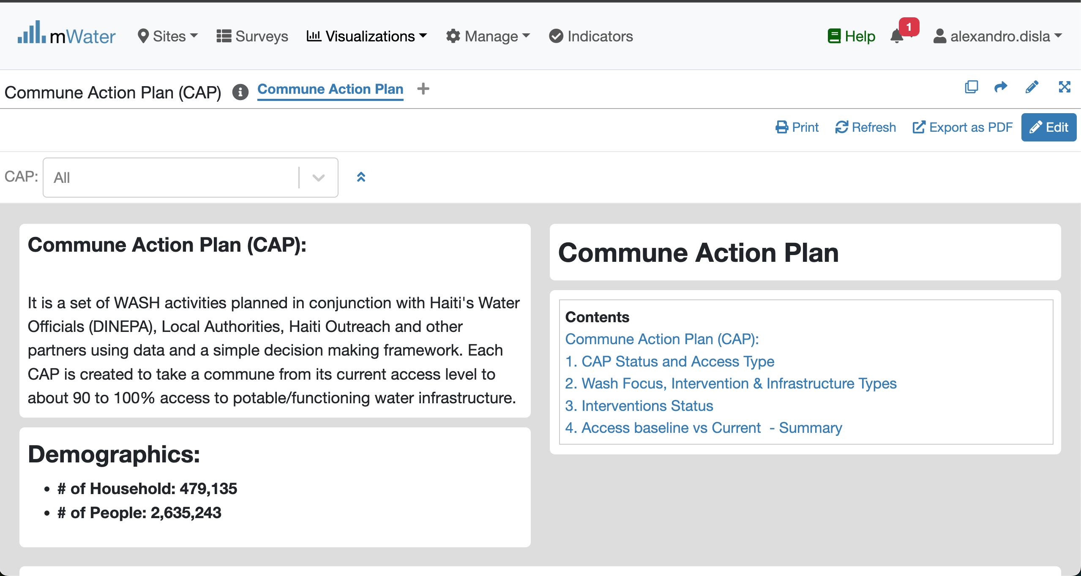
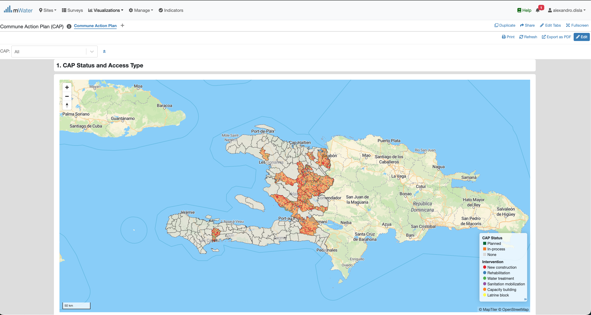
CAP Console overview

Slide 8
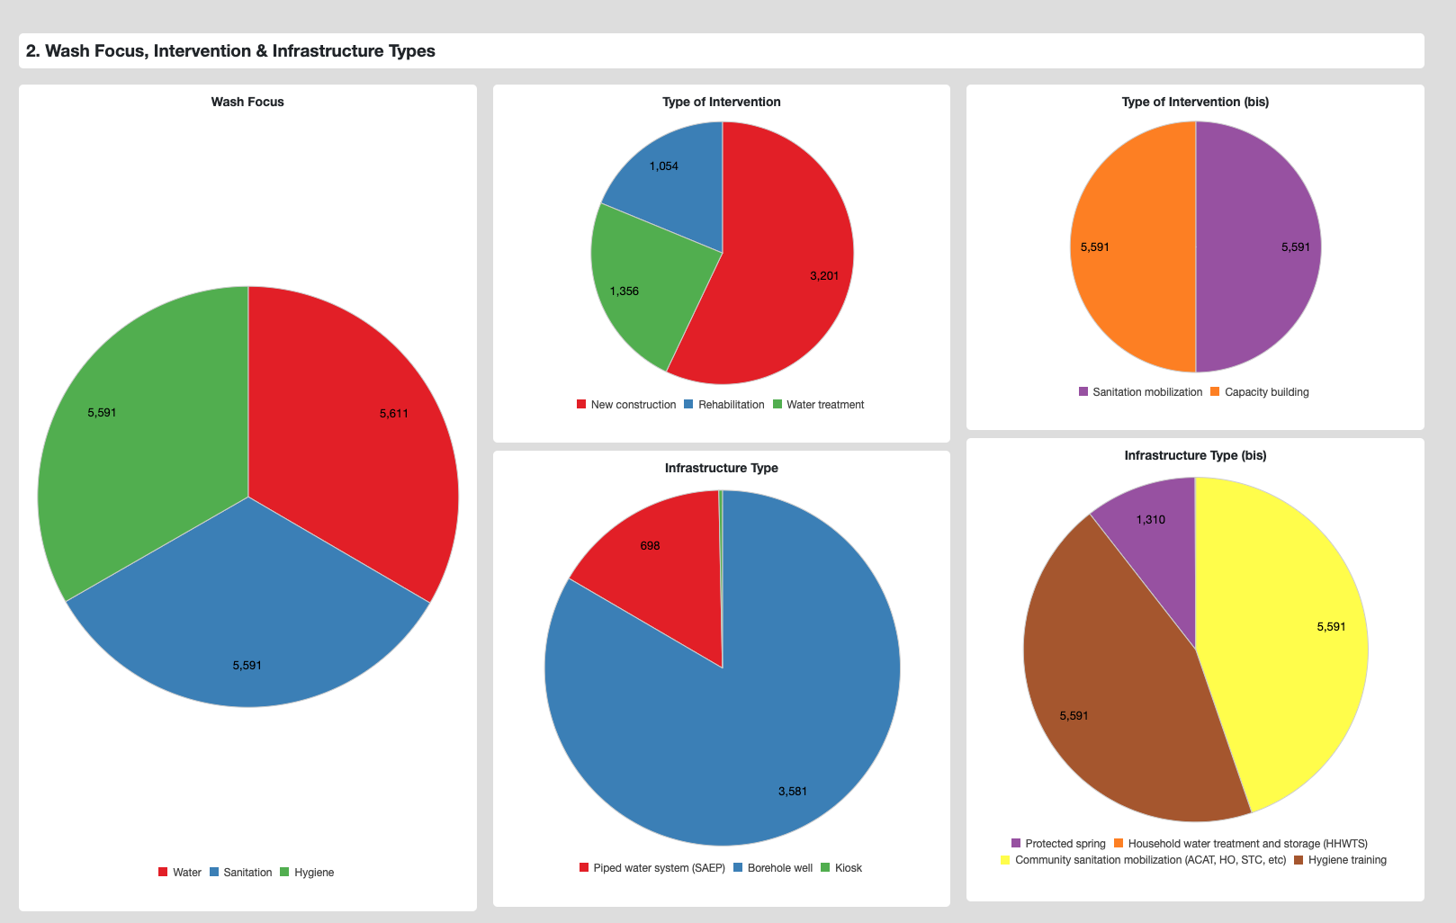
CAP Console overview

Slide 9
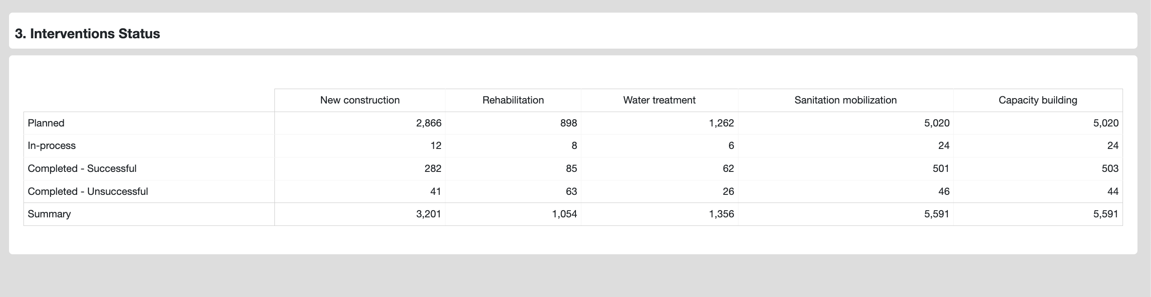
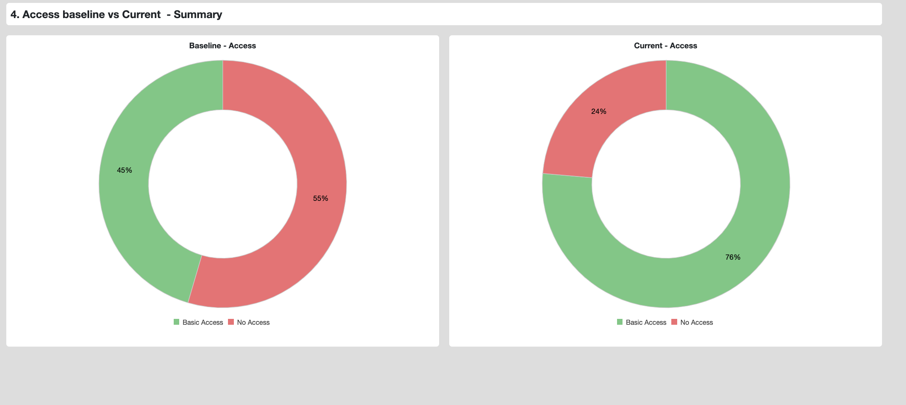
CAP Console overview

Slide 10
Functionalities
Functionalities available in the console

Slide 11
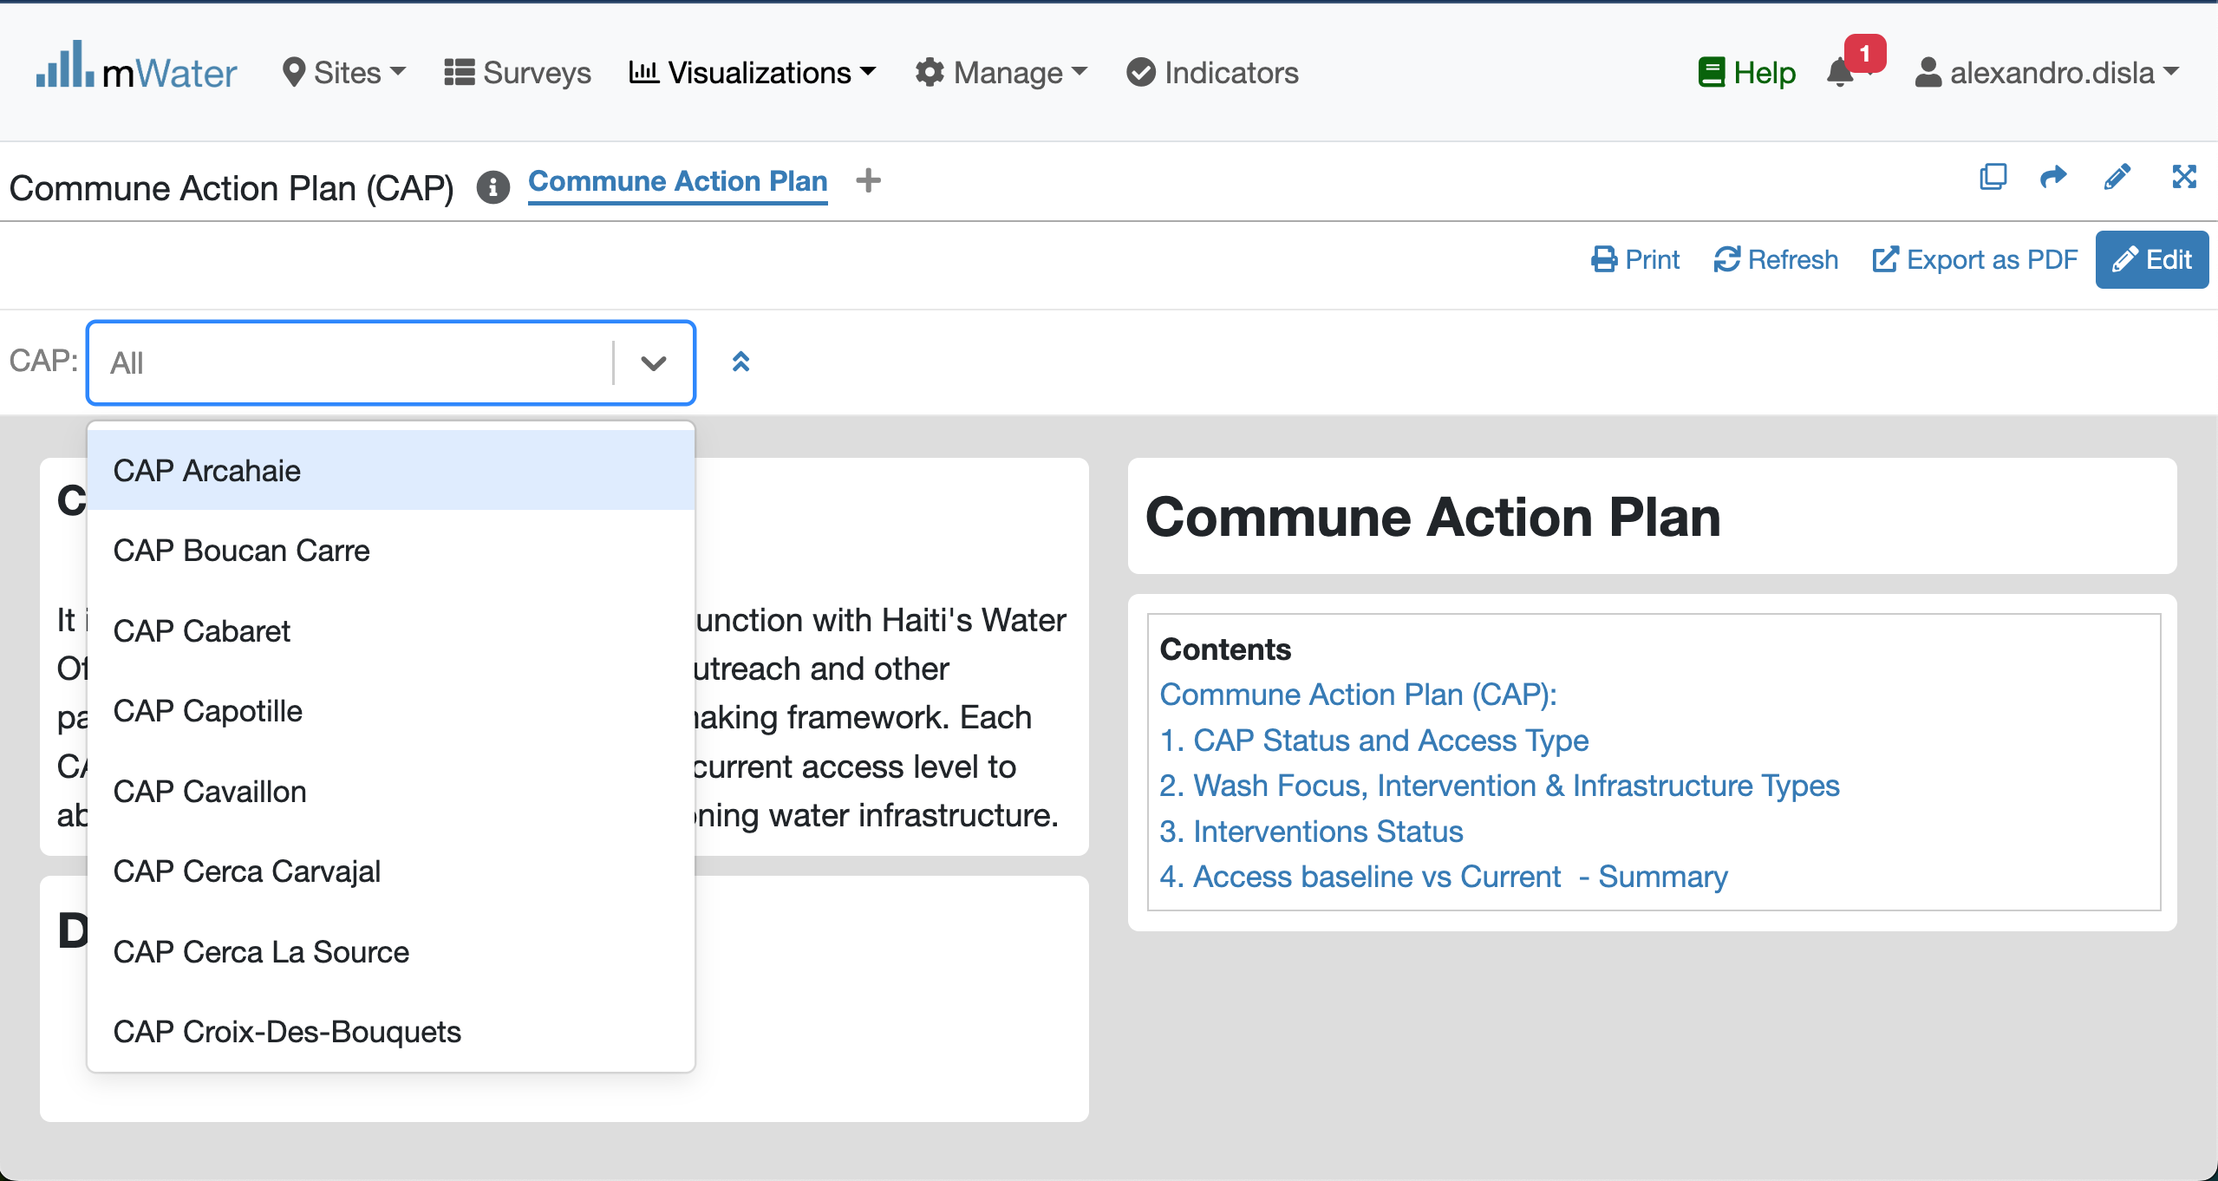
Quick filters
Click to get the dropdown list
Please Select one CAP unit

Slide 12
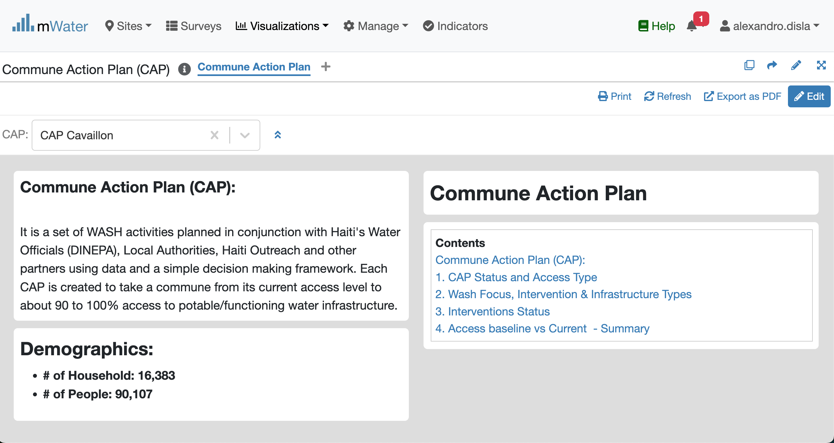
Effect of the Quick Filters

Slide 13
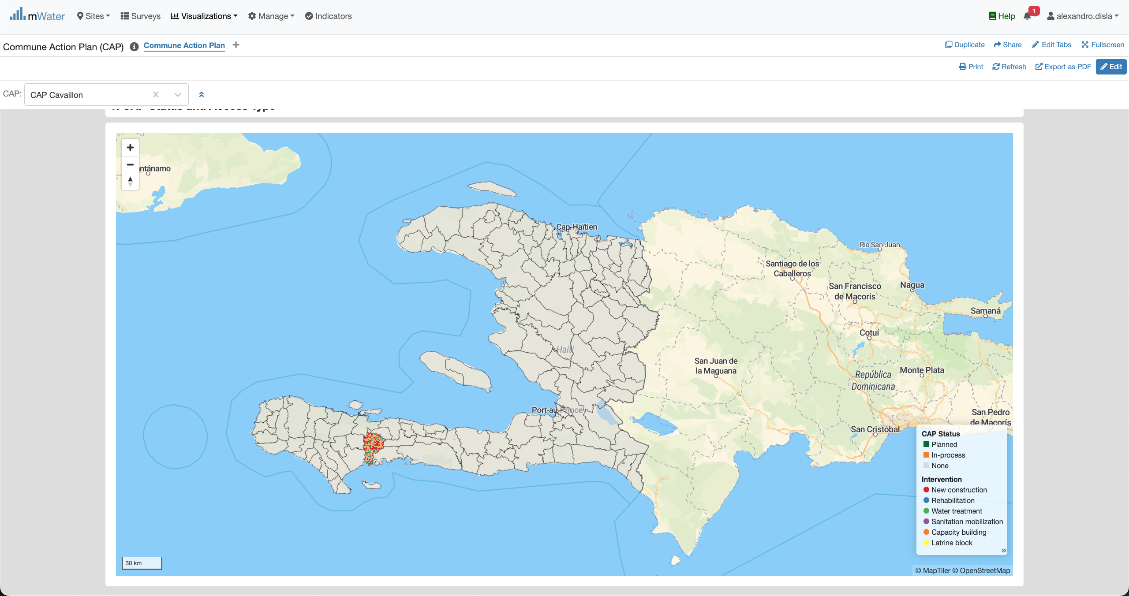
The Map

Slide 14
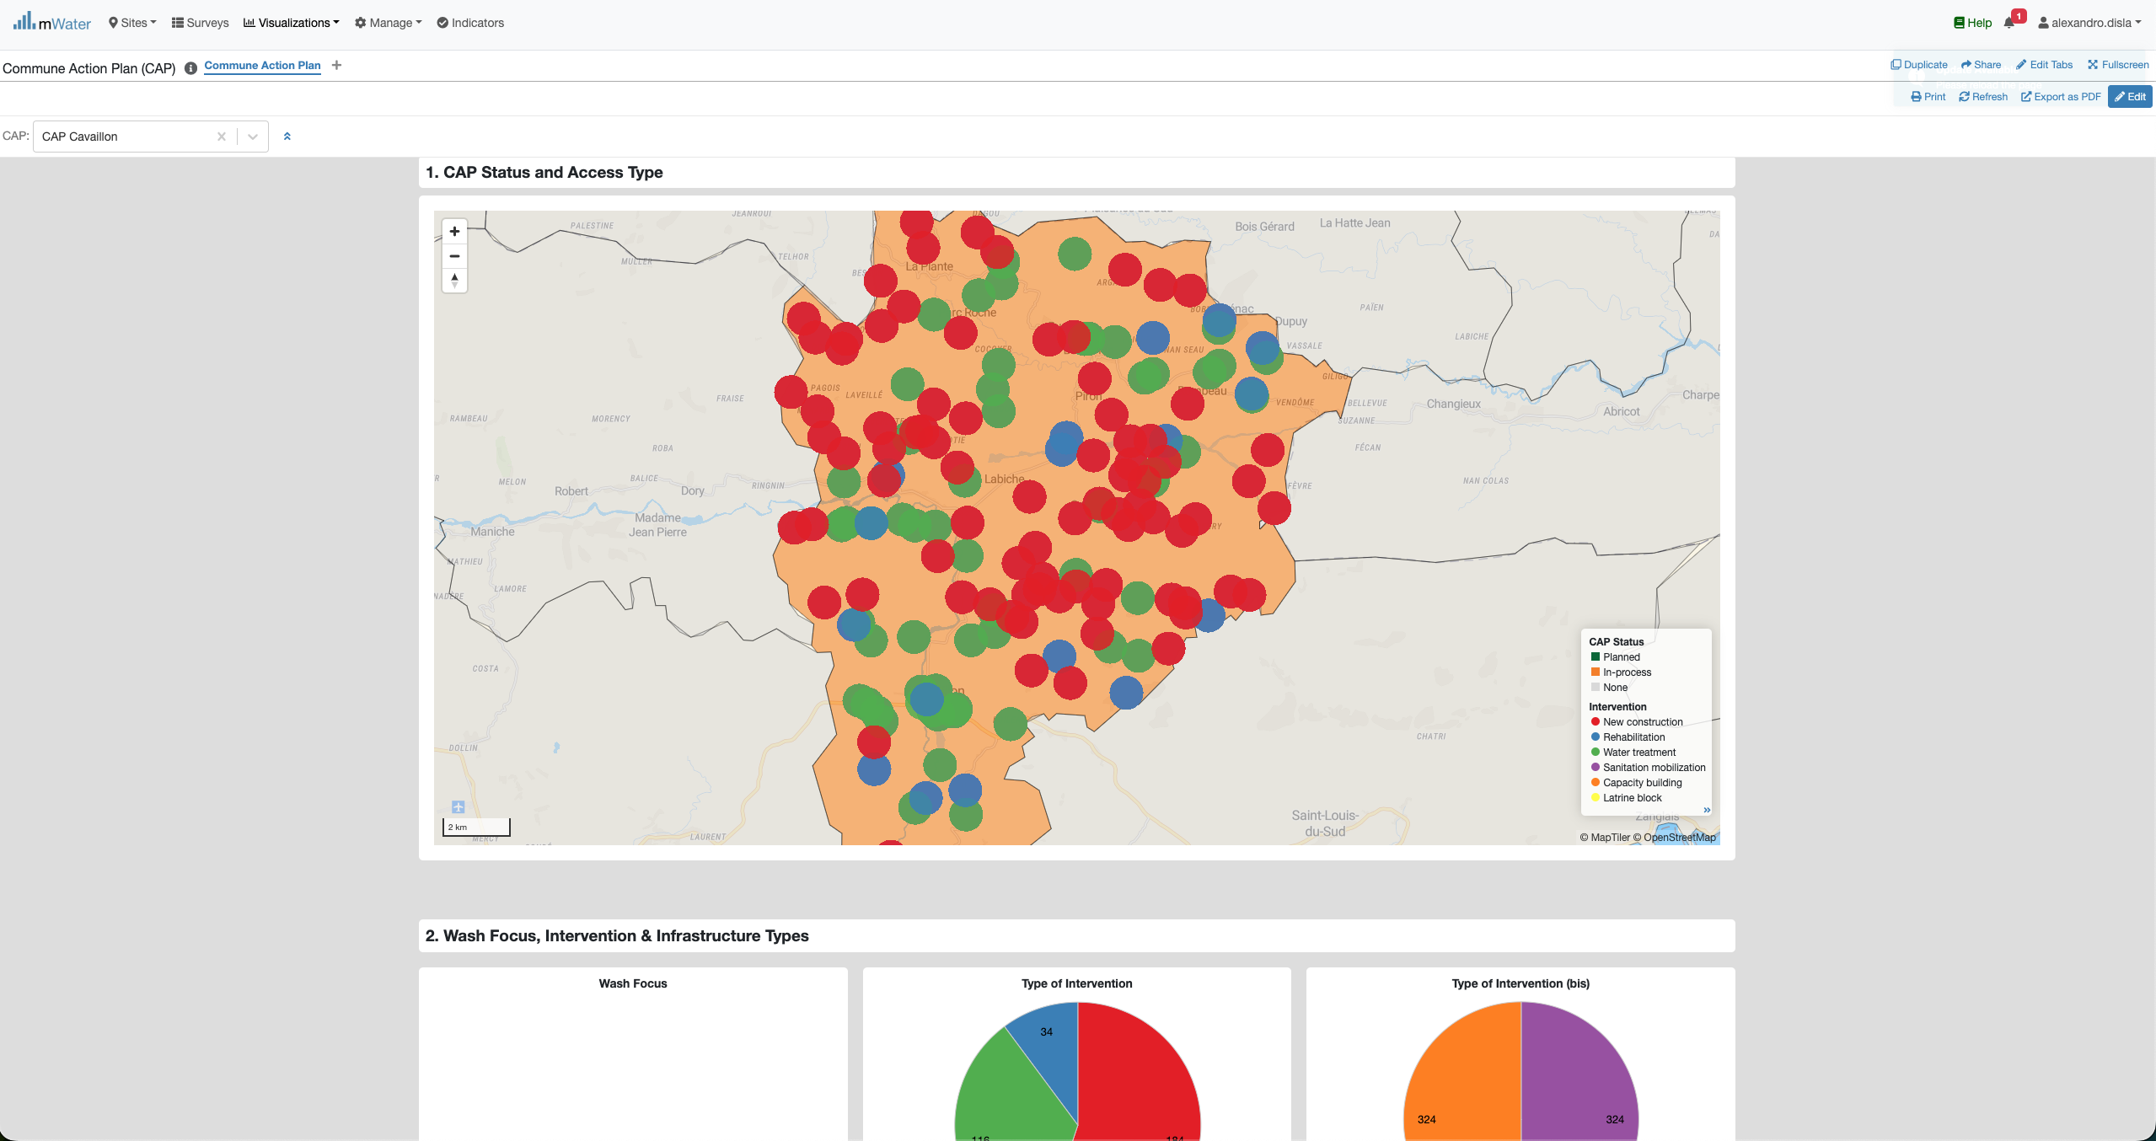

The map- Zoom
Zoom Control
Help you go over the map.

Slide 15
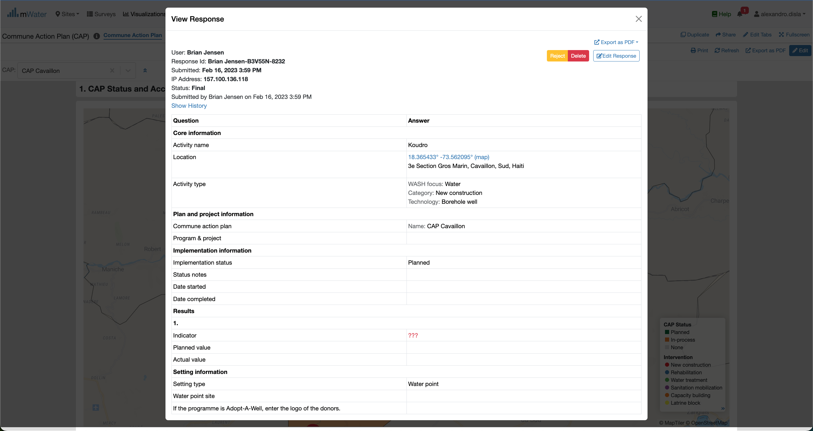
MAP – selection of a Point

Slide 16
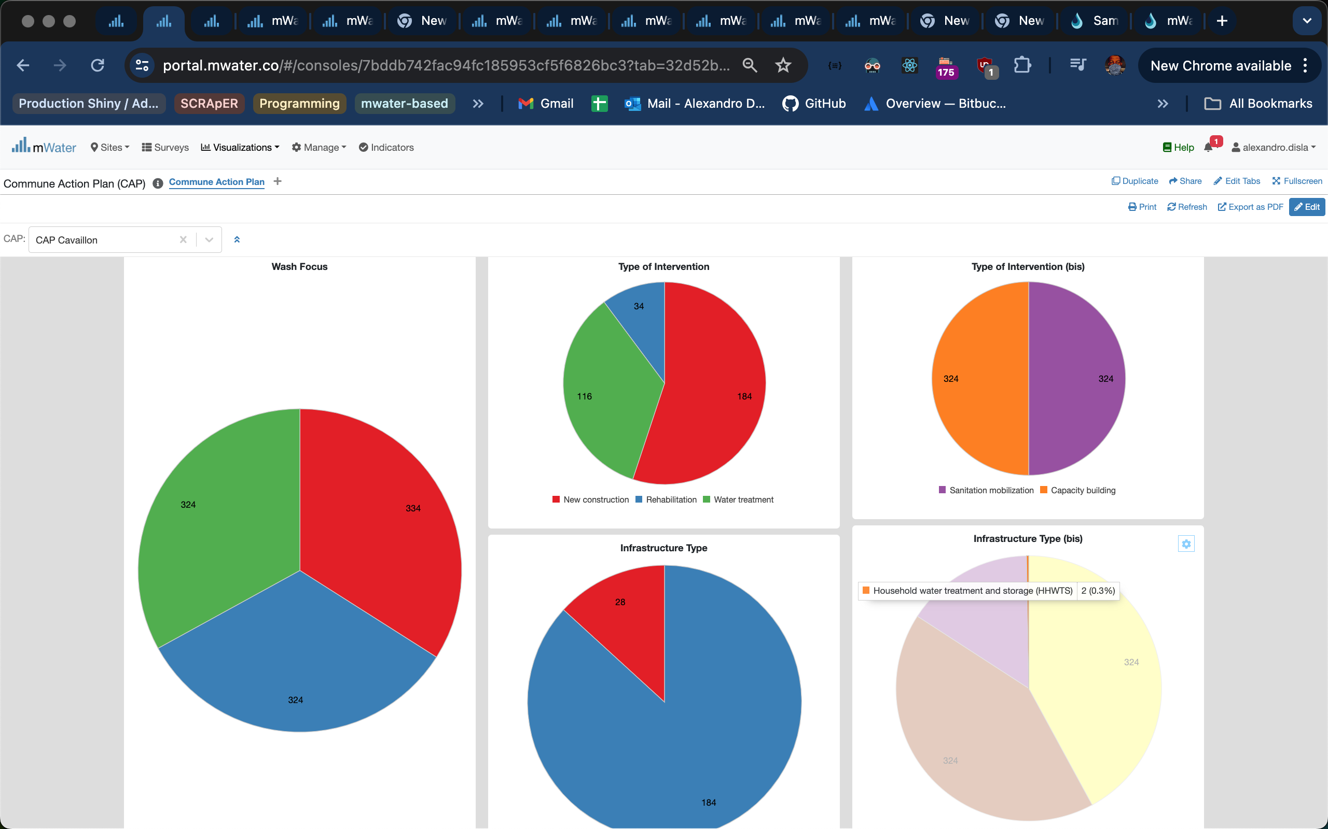
Pie Charts
Instant Hover Effect

Slide 17
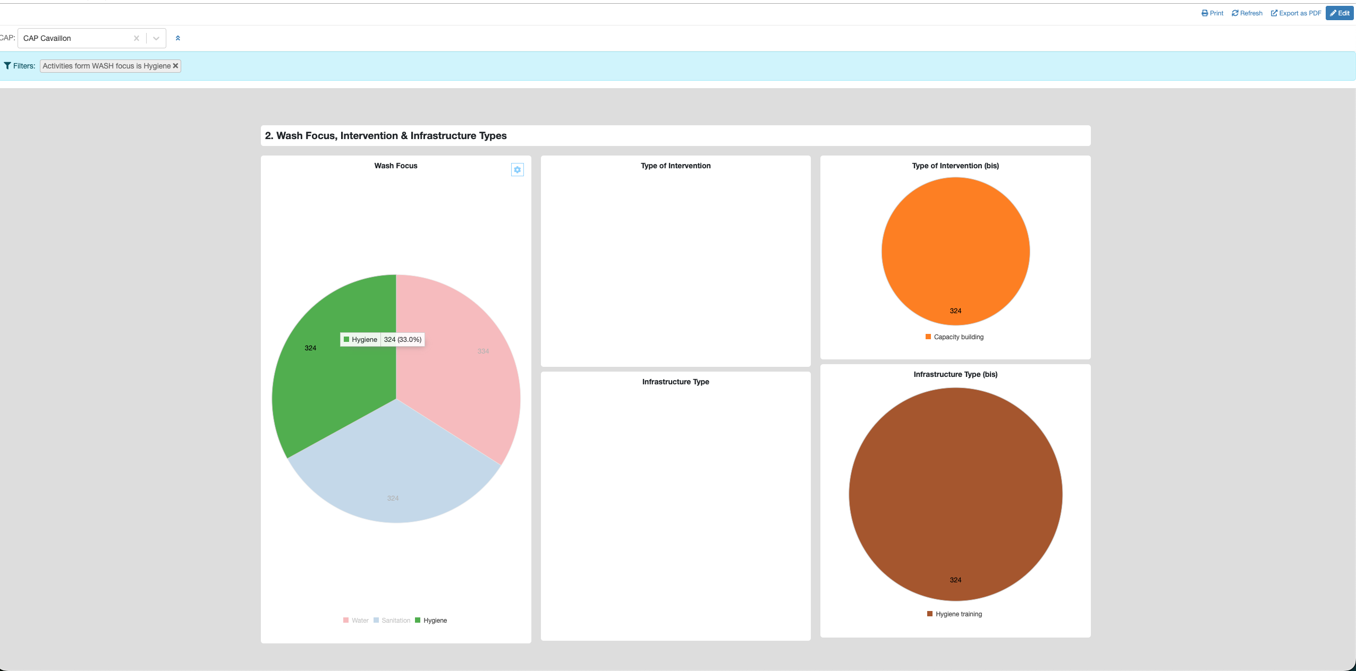
Pie Charts
Click on the x button to close this filter view
A new filter view is now open
Click on a wash focus
The cluster react to the selection

Slide 18
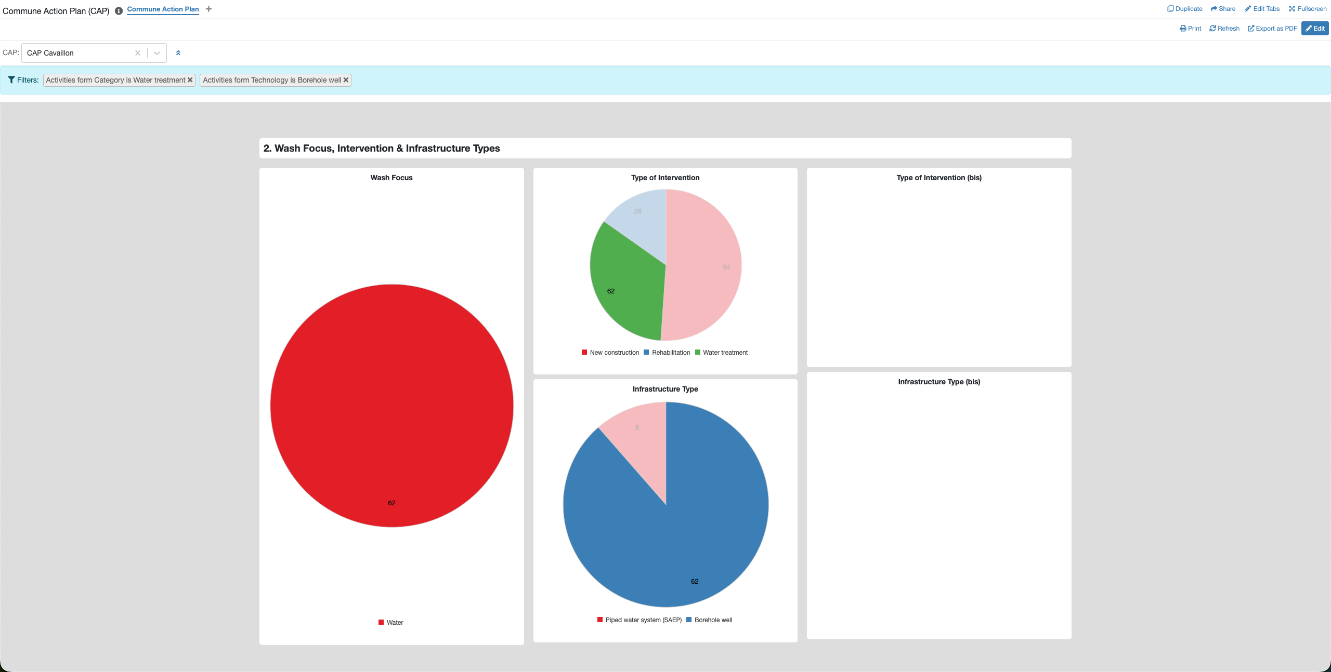
Pie Charts
When it make sense, you can select segment from different related pie charts
The filter view support multiple selection. If the logic make sense.

Slide 19
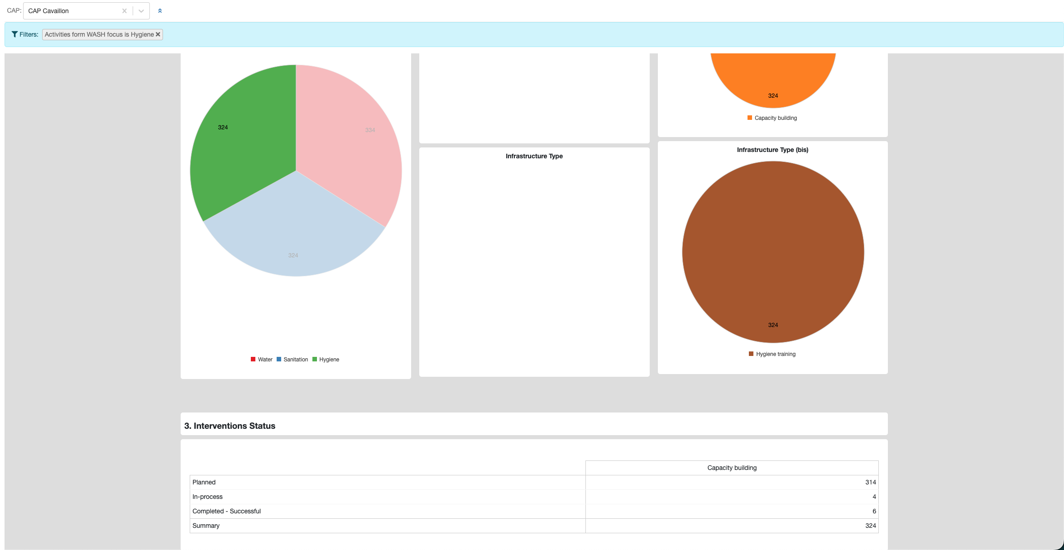
Pivot table & Pie CHarts
One of the wash focus has been selected
The filter View.
The table will redisign itself to make sense
The pivot table is link logically with the pie chart cluters

Slide 20
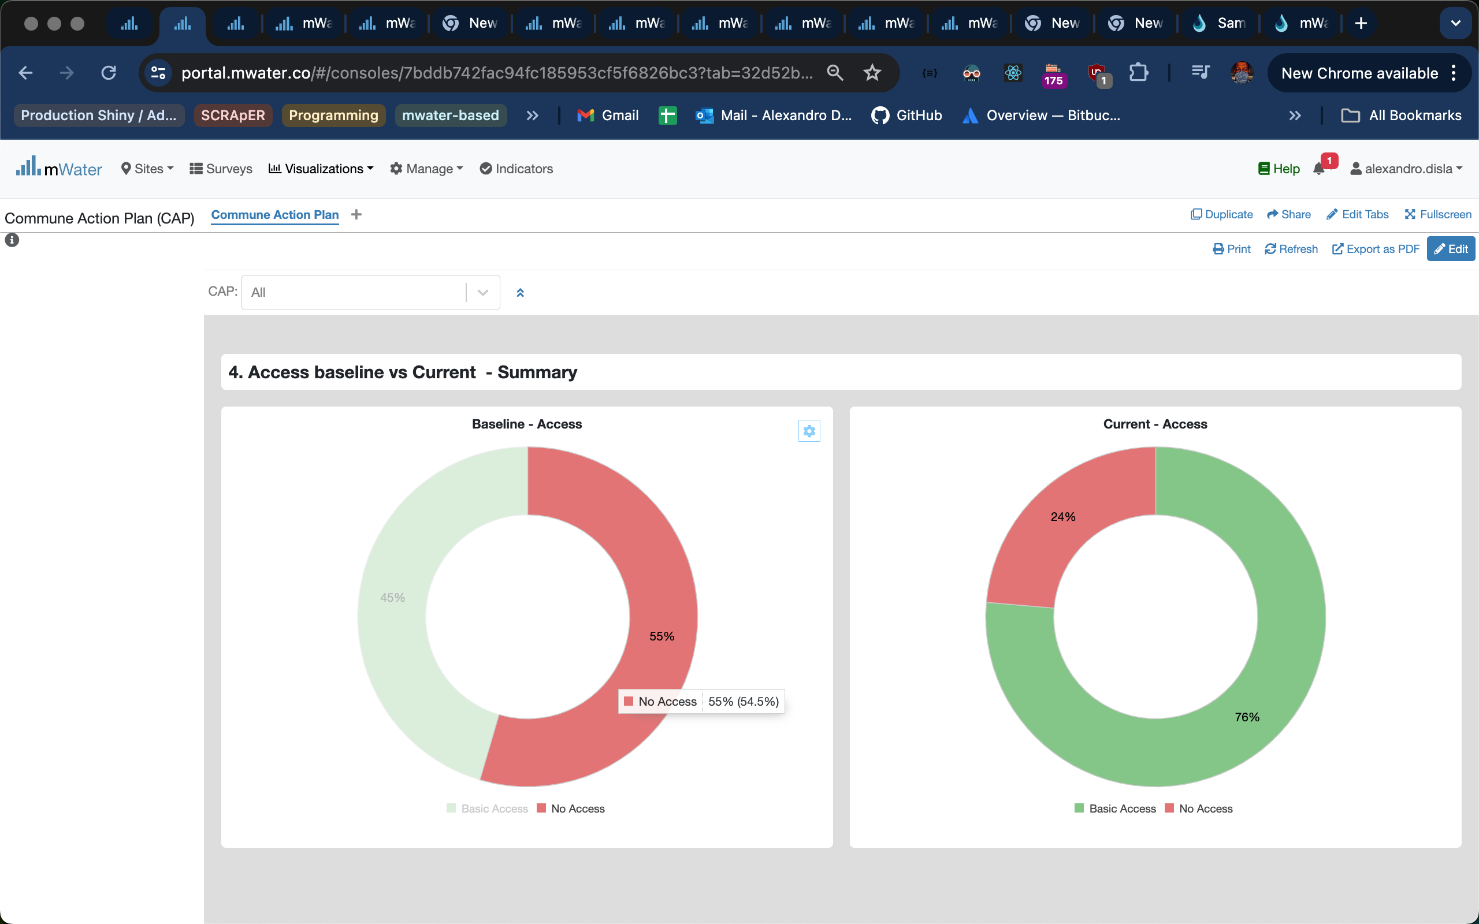
Donut Charts
Hover Effect feature

Slide 21
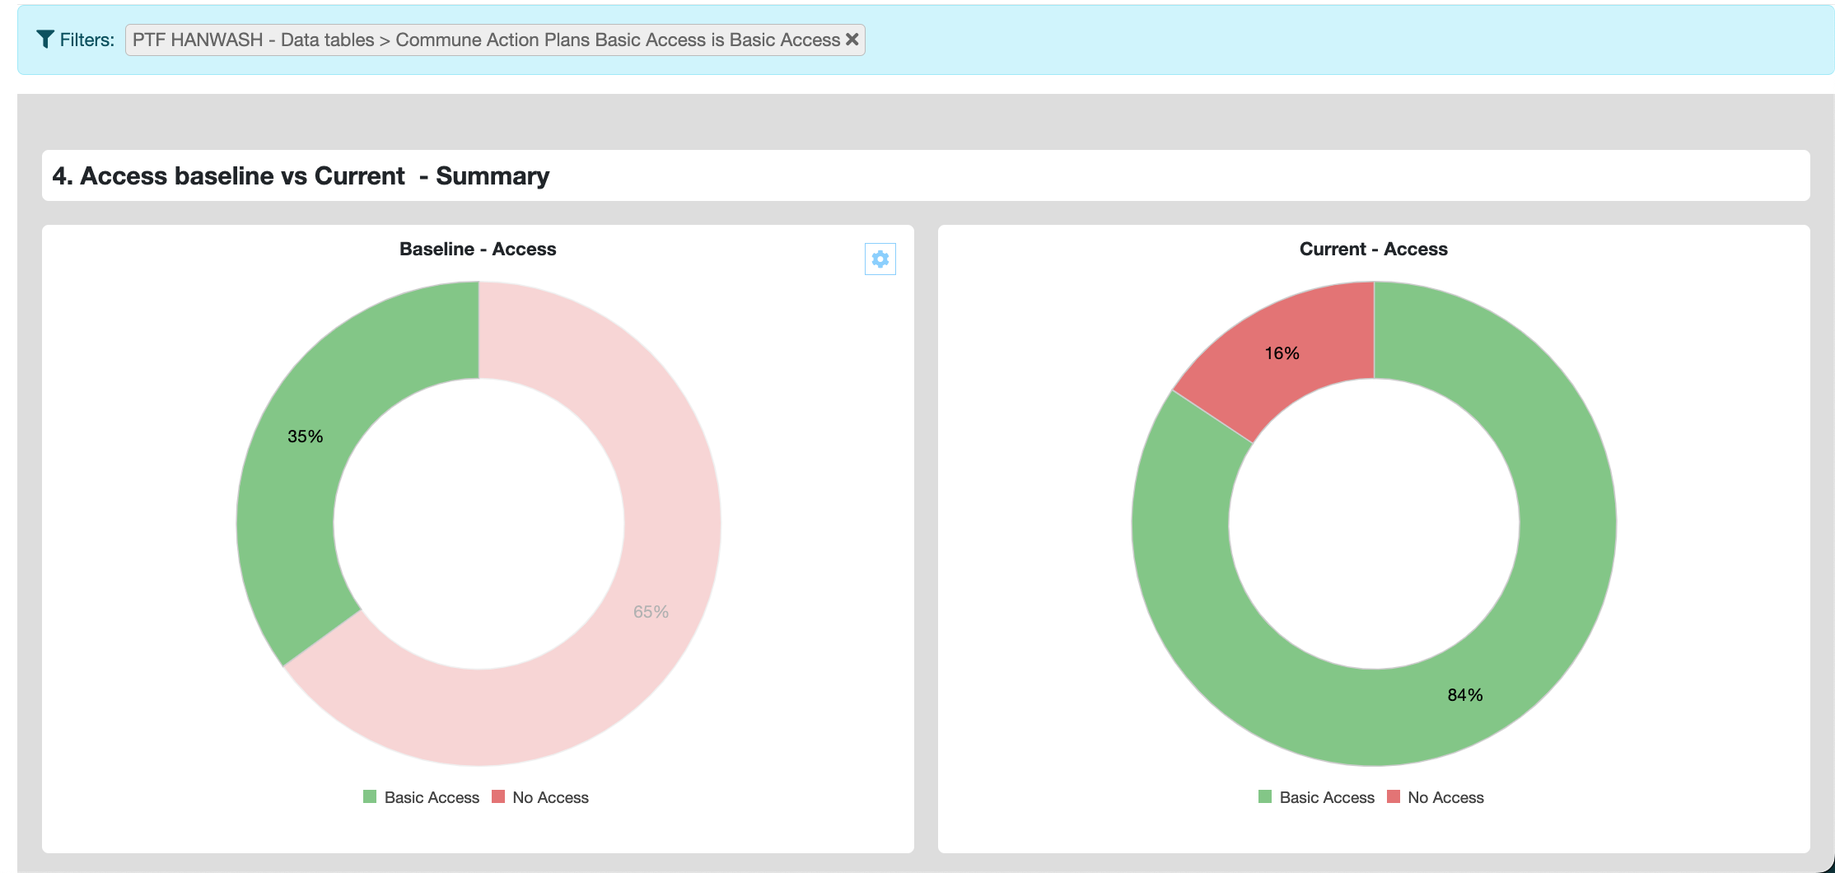
donut Charts

